Slide 1
CREDIT CARD FRAUD DETECTION

Slide 2
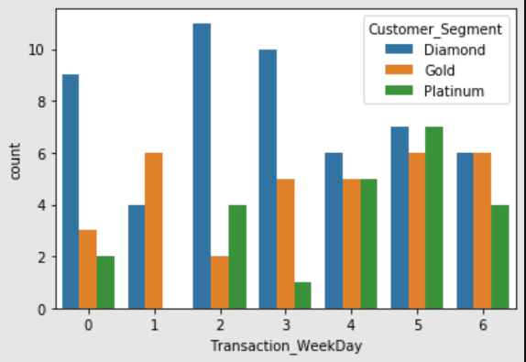
Customer_Segment-DayOfWeek
Most number of fraudulent transactions are done by ‘Diamond’ Segment and mostly on Tuesday-Wednesday.

Slide 3
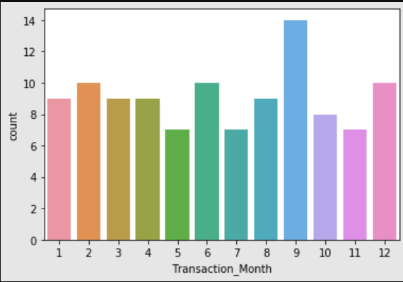
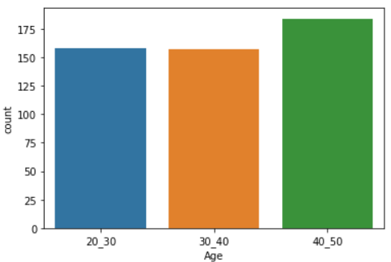
Frequency of Fraud is highest in the Month of September.
Age Group of 40-50 has most fraud transactions.
This might be because of technology user experience.

Slide 4
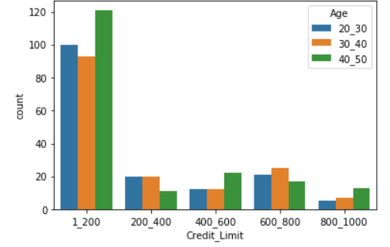
Credit Limit of 1-200K has the highest frequency.

Slide 5
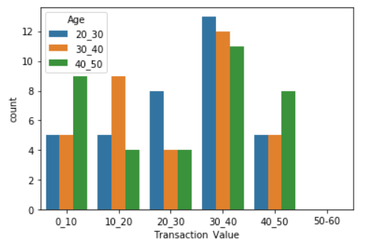
Transaction Value of 30K – 40K has highest Fraud Frequency

